Slide 1
Testing: An Overview
Yuqun Zhang
CS304
Based on slides from Christine Julien, Miryung Kim and Adnan Aziz

Slide 2
Testing
It’s a fundamental and absolute necessity
Historical Examples
Mars Climate Orbiter – metric/Imperial units for force
Therac-25 – concurrent programming errors (mishandling of a race condition) give massive radiation overdoses
ARIANE 5 – floating point to integer overflow
Healthcare.gov – failed to perform integration testing
Anecdotal data
One to five errors per KLOC in mature software
More than 10 bugs for KLOC in prototype
Largely independent of programming language

Slide 3
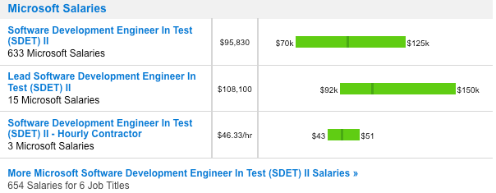
Testing
Testing is the most popular quality-assurance activity
Software development engineer in test (SDET)
“Half of my engineers are testers, the rest spend half of their time testing.” – Bill Gates

Slide 4
Testing
A practice supported by a wealth of industrial and academic research and by commercial experience
Testing and code review/inspection are the most common quality assurance methods
Testing is a means of detecting/revealing errors
Debugging is a means of diagnosing and correcting the root causes of errors that have already been detected

Slide 5
Kinds of Testing
Unit testing: the execution of a complete class, routine, or small program or team of programmers
Component testing: the execution of a class, package, small program, or other program element
Integration testing: the combined execution of two or more classes, packages, components, or subsystems
System testing: the execution of the software in its final configuration, including integration with other software and hardware systems
Regression testing: the repetition of previously executed test cases for the purpose of finding defects

Slide 6
Types of Testing
Black-box testing: tests in which the test cannot see the inner workings of the item being executed
White-box testing : tests in which the tester is aware of the inner workings of the item being tested

Slide 7
Developer Testing in Software Quality
Testing’s goal runs counter to the goals of other development activities
Testing can never completely prove the absence of errors
Testing by itself does not improve software quality
Testing requires you to assume that you will find errors in your code
Limitations:
Developers tend to have an optimistic view of test coverage
Developers tend to skip more sophisticated kinds of test coverage

Slide 8
Test Adequacy Criteria: Why?
Problem 1: Sometimes developers do not write enough tests
Problem 2: Sometimes developers write too many redundant tests, causing quality assurance overhead
Problem 3: During software evolution, we do not have time to rerun all of the tests; identifying the most relevant tests (relevant to code change) is hard

Slide 9
Test Coverage
Statement coverage: has each statement been executed?
Branch coverage: has each control structure evaluated to both true and false?
Path coverage: has every possible route been executed?

Slide 10
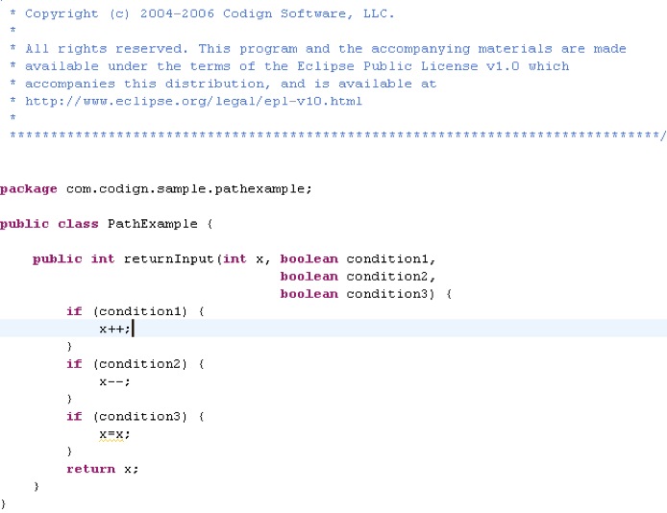
Branch and Path Coverage Example

Slide 11
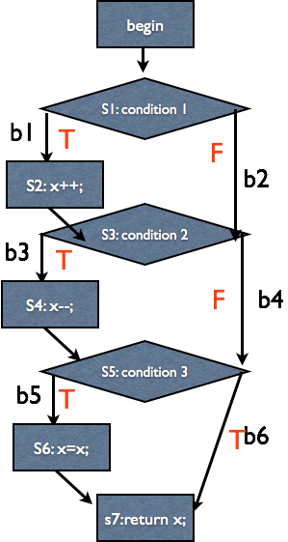
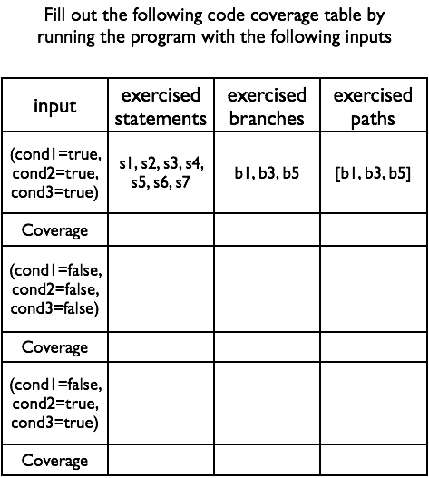
Branch and Path Coverage Example

Slide 12
This Can Quickly Get CRAZY
public static int fun1(int N) {
int sum = 0;
for (int i = 1; i <= N; i++) {
for (int j = 1; j <= Math.pow(3, i); j++) {
System.out.println("HelloWorld");
if (new Random().nextInt() % 2 == 0)
sum++;
}
}
return sum;
}
Has an exponential number of paths

Slide 13
JUnit
Automated unit testing framework
Provides the required environment for the component
Executes the individual services of the component
Compares the observed program state with the expected program state
Reports any deviation from the expectations
Does all of this automatically

Slide 14
Validating Program States
The main tool of component test is the comparison of the observed state with the expected state
assertions
assert in JAVA (JDK 1.4 and later)

Slide 15
assert(b)
If b is true, nothing happens—the assertion passes
If b is false, a runtime error occurs
C and C++, similar to executing abort()
Java, raise AssertionError exception

Slide 16
Example: Comparison of Rational Numbers
Identity, e.g., 1/3 = 1/3
Different representation, e.g., 2/6 = 1/3
Integers, e.g., 3/3 = 1
Nonequality, e.g., 1/3 != 2/3

Slide 17
Example: Comparison of Rational Numbers
class RationalAssert {
public static void main(String args[]){
assert new Rational(1,3).equals(new Rational(1,3));
assert new Rational(2,6).equals(new Rational(1,3));
assert new Rational(3,3).equals(new Rational(1,1));
assert !new Rational(2,3).equals(new Rational(1,3));
}
}
$ javac –source 1.4 RationalAssert.java
$ java –ea RationalAssert
Exception in thread “main”
java.lang.AssertionError at RationalAssert.main(RationalAssert.java:3)

Slide 18
Executing Component Tests
If a test fails, the subsequent test cases are no longer executed
One should be able to run tests individually, independent of other test cases
One should be able to group tests into test suites
One should be able to grasp immediately whether tests have failed and, if so, which ones

Slide 19
Enter JUnit...
Each test case is realized by its own class derived from JUnit TestCase class
Each test of the test case is realized by its own method whose names starts with test
assertTrue() method inherited from TestCase has the same meaning as assert

Slide 20
JUnit TestCase Example
import junit.framework.*;
public class RationalTest extends TestCase {
// Create new test
public RationalTest(String name) {
super(name);
}
public void testEquality() {
assertEquals(new Rational(1,3), new Rational(1,3));
assertEquals(new Rational(2,6), new Rational(1,3));
assertEquals(new Rational(3,3), new Rational(1,1));
assertFalse(new Rational(2,3).equals(new Rational(1,3)));
}
}
$ java –classpath .:/wherever/junit.jar junit.textui.TestRunner RationalTest

Slide 21
Setting up Fixture
Tests frequently need some fixture to execute
Configuration files that must be read and processed
External resources that must be requested and set up
Services of other components that must be initialized
Setting up:
The method setUp() is called before each test of the class
Tearing down:
The method tearDown() is called after each test (it is used for releasing the fixture)

Slide 22
Example Test Fixture
public class RationalTest extends TestCase {
private Rational a_third;
// Set up fixture
// Called before each testXXX() method
protected void setUp() {
a_third = new Rational(1,3);
}
// Tear down fixture
protected void tearDown() {
a_third = null;
}
...
}

Slide 23
Another JUnit Example
public class VectorTest extends TestCase {
protected Vector fEmpty;
protected Vector fFull;
// public VectorTest(String name);
protected void setUp() {
fEmpty = new Vector();
fFull = new Vector();
fFull.addElement(new Integer(1));
fFull.addElement(new Integer(2));
fFull.addElement(new Integer(3));
}
// continued…
Some state to refer to the SUT instance
Typically use the implicit constructor
Set up the test ficture

Slide 24
JUnit Example (continued)
// continued from previous slide
public void testCapacity() {
int size = fFull.size();
for(int I = 0; i< 100; i++) {
fFull.addElement(new Integer(i));
}
assertTrue(fFull.size() == 100 + size);
}
More exercise and setup code
This is the verification stage
When the assertion fails, we see:
Assertion failed: myTest.java:150 (expected true but was false)

Slide 25
JUnit Example (continued)
Well, that’s not particularly helpful.
What if we write it like this?
assertEqual(100+size, fFull.size());
When this fails, we’ll see
Assertion failed: myTest.java:150 (expected 103 but was 102)
What’s the moral?
Always put the expected value as the first argument in AssertEqual
One more note…
An even better assertion is
assertEqual(“newlength”, 100 + size, f.Full.size());
Assertion failed: myTest.java:150 (newlengyh expected 103 but was 102)

Slide 26
More about Assertions
General rule: always put messages in assertions
Often need fuzzy checks
E.g., assertAlmostEqual(int expected, int found, int tolerance)
Checks whether found lies in the range of [expected – tolerance, expected + tolerance]
You can create your own assertions
assertStringContains(String needle, String haystack)
Makes for much more informative errors
E.g., compare to assertTrue(haystack.contains(needle))

Slide 27
Example
At least one test for every API method
public void testClone() {
Vector clone = fFull.clone();
assertTrue(clone.size() == fFull.size());
assertTrue(clone.contains(new Integer(1)));
}
public void testCloneEmpty() {
Vector clone = new Vector();
assertTrue(clone.size() == 0);
}
public void testContains() {
assertTrue(fFull.contains(new Integer(1)));
assertTrue(!fEmpty.contains(new Integer(1)));
}
Test corner cases separately
Purists will insist that each test test only one thing

Slide 28
Example (continued)
public void testRemoveAll() {
fFull.removeAllElements();
fEmpty.removeAllElements();
assertTrue(fFull.isEmpty());
assertTrue(fEmpty.isEmpty());
}
It’s fine to change the fixture: each test sets up from scratch
JUnit 4.0 introduced @BeforeClass annotation, providing a way to run a class-wide setup method before any of the tests of that class are done
Useful when a test fixture is too expensive to set up with every test

Slide 29
Example (continued)
public void testElementAt() {
Integer i = (Integer) fFull.elementAt(0);
assertTrue(i.intValue() == 1);
try {
Integer j = (Integer) fFull.elementAt(fFull.size());
fail(“Should raise an ArrayOutOfBoundsException”);
} catch (ArrayOutOfBoundsException e) {
return;
}
}
Test error cases also, by forcing exceptions and catching them

Slide 30
Test Automation
Tests must be runnable by script:
You won’t run them often
You’ll forget how to set them up and run them
Tests should verify their own results without any human intervention
Automated tests should be repeatable
On your machine and on someone else’s
Automated tests should be robust
A failure should point to a bug (in the SUT or in the test)
What’s a bug? Something that leads to code being changed
Tests should be fast: want timely feedback

Slide 31
Questions?

Slide 32
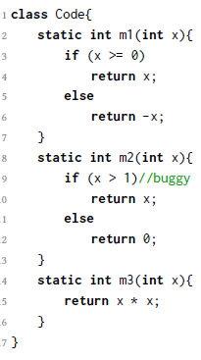
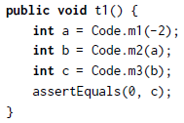

Let's think a bit further...
Take a look at the following codes

Slide 33
Let's think a bit further...
Both would fail
But can you get anything more
out of it?
We are pretty sure m2 is faulty
from t2. But are we so sure from
t1 about it?

Slide 34
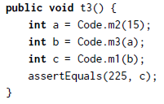

Let's think a bit further...
Both t3 and t4 pass
Does that necessarily mean m2 is correct?

Slide 35
Let's think a bit further...
A little intuition:
A method in a failed unit test must be faulty
A method in a passed unit test is not necessarily correct
A method covered by many failed tests tends to be faulty
A method covered by many passed tests tends to be correct

Slide 36
Let's think a bit further...
A little intuition:
A method in a failed unit test must be faulty
A method in a passed unit test is not necessarily correct
A method covered by many failed tests tend to be faulty
A method covered by many passed tests tend to be correct
Now, in a real-world software project, given thousands of methods, tens of thousands of tests, how can you
tell a method is faulty or not?
identify all the faulty methods?

Slide 37
Let's think a bit further...
We rank!

Slide 38
Let's think a bit further...
We rank!
Given
ef: the number of failed tests executing the program entity e (method, function, etc)
ep: the number of passed tests executing the program entity e
nf: the number of failed tests that do not execute the program entity e
np: the number of passed tests that do not execute the program entity e

Slide 39
Let's think a bit further...
We rank!
Given
ef: the number of failed tests executing the program entity e (method, function, etc)
ep: the number of passed tests executing the program entity e
nf: the number of failed tests that do not execute the program entity e
np: the number of passed tests that do not execute the program entity e
How would you like to design your ranking formula?

Slide 40
Fault Localization
Fault localization refers to the process of localizing faults by ranking the methods according to their suspicisousness of being faulty.

Slide 41
Fault Localization
Fault localization refers to the process of localizing faults by ranking the methods according to their suspicisousness of being faulty.
Some of you must have already brought about a ranking formula
ef/(ef+ep)? It is called “Kulczynski”.
ef/(ef+ep+nf)? It is called “Jaccard”.
1-ep/(ef+ep)? It is called “SBI”.
ef^2/(ef+ep)? It is called “DStar2”.
...
There are 34+ popular fault localization formulas.

Slide 42
Spectrum-based Fault Localization (SBFL)
The ranking formulas reflect the information between test cases and methods, which is defined as “spectrum”.
In spetrum-based fault localization, the methods that rank top are recommened to testers for efficient debugging process.

Slide 43
thoughts?

Slide 44
Why do we need ranking formulas for fault localization techniques?
Can we just design unit tests for each method? If the test fails, the method is simply faulty.
The problem is, sometimes it is hard to design unit tests for every single method.
If you have methodA(Object O), O might be too hard to be separated from running programs before being passed to methodA.
In this case, one has to include the method that delivers Object O in test cases together with methodA.

Slide 45
How do we evaluate SBFL techniques?
We need to use benchmarks for evaluating the efficacy of SBFL techniques.
Defects4j is one important benchmark of Java bugs.
with 5 projects, 357 reproducible bugs (later on, another project was added with additional 38 bugs).
Top-N recommendation is the metric to delineate the SBFL efficacy.
Examine whether any Top-N result matches benchmark bugs
Compare the Top-N results of different SBFL techniques.

Slide 46
Defects4J statistics
ID | Program | #Faults | LoC | #Tests
Chart | JFreeChart | 26 | 96K | 2205
Closure | Closure Compiler | 133 | 90K | 7927
Lang | Commons Lang | 65 | 22K | 2245
Math | Commons Math | 106 | 85K | 3602
Time | Joda-Time | 27 | 28K | 4130
Real-Bug Total | 5 projects | 357 | 321K | 20109

Slide 47
How about SBFL performance
ID | Program | #Faults | LoC | #Tests
Chart | JFreeChart | 26 | 96K | 2205
Closure | Closure Compiler | 133 | 90K | 7927
Lang | Commons Lang | 65 | 22K | 2245
Math | Commons Math | 106 | 85K | 3602
Time | Joda-Time | 27 | 28K | 4130
Real-Bug Total | 5 projects | 357 | 321K | 20109
SBFL | Top-1 | Top-3 | Top-5
Tarantula | 66 | 172 | 215
SBI | 66 | 172 | 215
Jaccard | 70 | 169 | 213
Kulczynski | 70 | 169 | 213
Dstar2 | 73 | 171 | 209
Op2 | 77 | 166 | 206

Slide 48
Some observations
Well, it seems that SBFL techniques work.
For Top-1, ~70/357 bugs can be localized. For Top-5, >200/357 bugs can be localized.
Is it good enough?...Nay!
Why?
For Top-1, ~20% surely is not exciting.
For Top-5, the result seems to be exciting.
But do we really care?
Recall that debugging is tedious and expensive, locating for one more time implies double efforts. So one needs to pay 5ish more times of efforts to locate ~200 bugs.
Is it worthy? You do the math.

Slide 49
Onion peeling time

Slide 50
Onion peeling time
So, what is our direction to improve SBFL?

Slide 51
Test Case Purification (Xuan et al, FSE'14)
The goal of test case purification is to separate existing test cases into small fractions.
Motivation:
It is quite often that a test case includes multiple assertions.
“Apache Commons Lang (Version 2.6), consists of 1874 test cases with 10869 assertions testing the behavior of over 55K lines of code. That is, each test case includes 5.80 assertions on average.”
What if a test case with multi-assertions is split into multi-test-cases with single assertions?
And how do we do it?

Slide 52
The Approach
There are three steps of test case purification
test case atomization
test case slicing
rank refinement

Slide 53
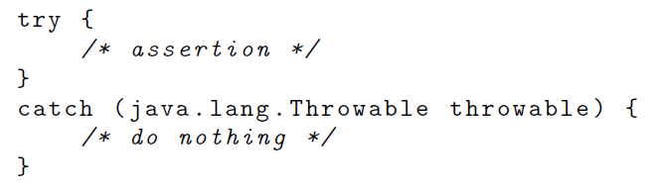
Test Case Atomization
transform a test case with multi-assertions to multiple test cases with single assertions
But things are not that simple: how do we exactly avoid the effects of the redundant assertions?
An intuitive solution
We transform the redundant assertions to a “try-catch” structure.

Slide 54
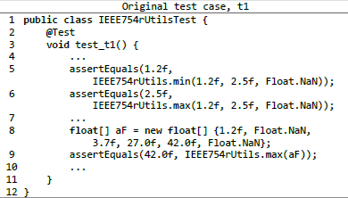
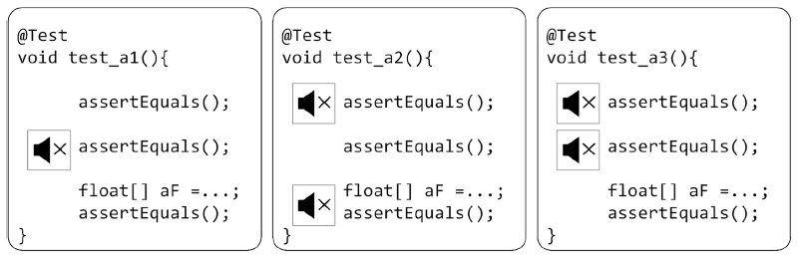
Test Case Atomization (Cntd.)
Example:

Slide 55
Test Case Slicing
“Given a failing single-assertion test case resulting from test case atomization, we slice this test case by removing irrelevant statements.”
Dynamic slicing: remove irrelavant statements according to runtime execution.

Slide 56
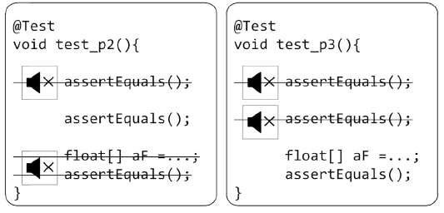
Test Case Slicing (Cntd.)
Example:

Slide 57







Rank Refinement
Rerank the statements according to the purifed test cases.
Design a new ranking formula.
, where and are the numbers of test cases covering and non-covering s.
, where and are the minimum score and the maximum score for all the statements in S, respectively.
Or, you can use the tradional SBFL formulas (e.g, Jaccard, SBI).

Slide 58
Evaluations
Dataset: 1800 artificial bugs on programs in java libraries, including JExel 1.0.0 beta13, JParsec 2.0.1, Jaxen 1.1.5, Apache Commons (AC) Codec 1.9, Apache Commons (AC) Lang 2.6, Joda Time 2.3.

Slide 59
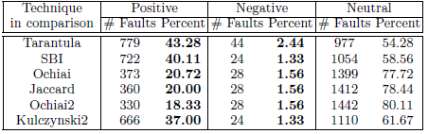
Evaluations
Number of faults where test case purification improves existing fault localization techniques (column Positive), worsens (column Negative) and has no impact (column Neutral) based on wasted efforts (efforts spent on localizing faults. )
Results:

Slide 60
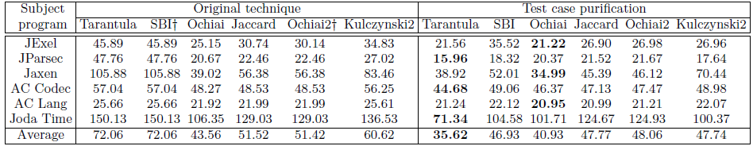
Evaluations (Cntd.)
Wasted effort (measured with the absolute number of statements to be examined before finding the fault). The wasted effort for the dataset is given on all six considered fault-localization techniques with and without test case purification. The last row averages over all subject programs.
Results

Slide 61
Onion peeling time
Let's comment this technique.

Slide 62


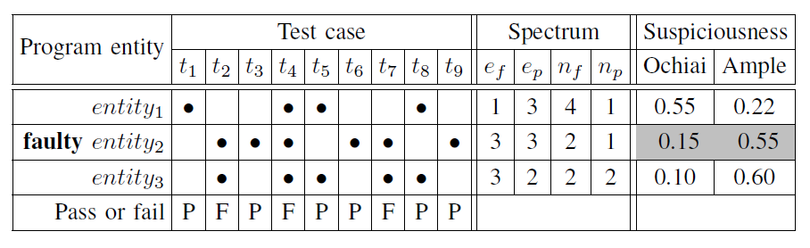
Multric: Learning to Combine Multiple Ranking Formulas (Xuan et al, ICSME'14)
Intuition: There are too many SBFL formulas. Their performance vary much.
Example
Ochiai and Ample rank different program entities as being faulty.

Slide 63

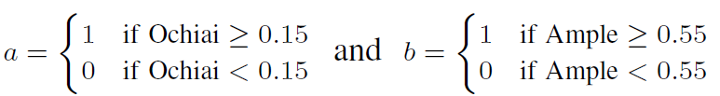
Intuition and Heuristics
Intuition (Cntd.)
We know that all SBFL formulas are proposed for certain reasons. Their performance are advanced here and there.
Heuristic: Can we do something to emphasize and combine their advantages?
More specifically, can we group all SBFL formulas as one?
How?
Ideally, we wish we can have something like this:
It would be good if a and b can be represented as

Slide 64
Multric Framework
How? (Cntd.)
Now the question turns out to be, how do we derive a and b?
An intuitive solution is, learning to rank.
Multric Framework:
Learning Phase
Collect the spectra of all faulty program entities (i.e., methods),
Compute the suspiciousness score of faulty program entities according to all SBFL techniques.
Combine all the SBFL scores, learn and tune the weights of them, form a new ranking model.
Ranking Phase
For a new faulty program, collect its spectrum, use the learned model to compute its suspisciousness score, rank it.

Slide 65


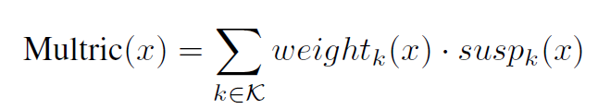



Learning Phase
Settings:
existing SBFL formulas ( = 25 )
) : set of faulty programs with test cases
The suspiciousness score of a program entitiy x in Multric is defined as
where denotes the suspiciousness score by a SBFL formula and denotes the weight of the SBFL formula k.

Slide 66
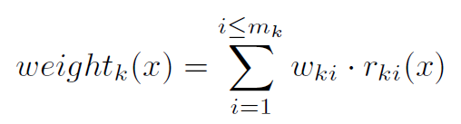







Learning Phase (Ctnd.)
where is a positive number, is a binary function that returns only 1 or 0, and is the times of tuning the weight for the metric k before the algorithm converges.
where is a learned constant as the threshold of the binary decision in and is a binary operator. = 1 if · is true and = 0 if · is false.

Slide 67



Learning to Rank (L2R)
How do we derive ?
Learning to Rank (L2R): takes partial order of data items for modeling to permutate new data items.
pointwise, pairwise, and listwise
pairwise L2R: when a query comes, return a document with higher score followed by another document for training a classification model.
In Multric, given a faulty program t, is defined as an ordered pair of a faulty entity and a non-faulty entity
. . This pair indicates an order that should be ranked above .

Slide 68
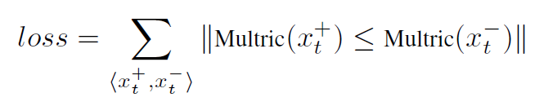
Learning to Rank (L2R) (Ctnd.)
The goal of learning the model is to determine the parameter values in the weighting structure, including and .
The loss function should be minimized.

Slide 69
Ranking Phase
Given a new faulty program, Multric
collects program spectra for all the entities,
uses all the existing SBFL techniques to calculate the suspiciousness scores of all the entities,
uses the learned model to calculate the Multric suspicisouness score out of all the SBFL scores.
ranks all the entities according to their Multric scores.

Slide 70
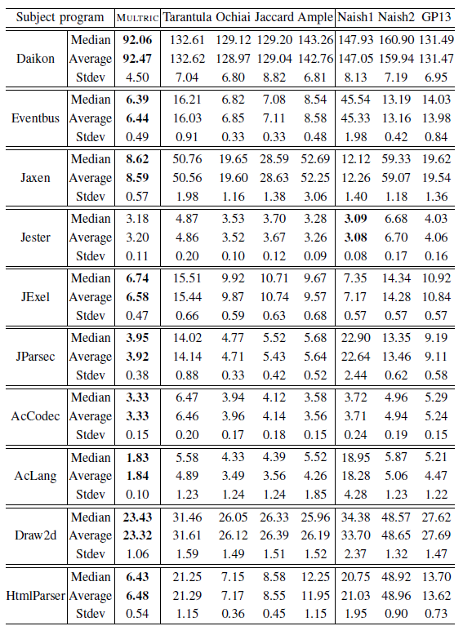
Evaluations
wasted efforts

Slide 71
Onion peeling time
Let's comment this technique.

Slide 72
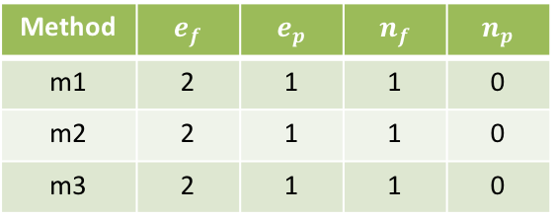
PRFL: PageRank-based Fault Localization (Zhang et al, ISSTA'17)
Let's take a look at the following codes
class ToyCode{
static int m1(int x){
//buggy, should be (x >= 0)
if (x >= 5)
return x;
else
return -x;
}
static int m2(int x){
//buggy, should be (x > 10)
if (x > 1)
return x;
else
return 0;
}
static int m3(int x){
return x * x;
}
}
public void t1() {
int a = ToyCode.m1(-2);
int b = ToyCode.m2(a);
int c = ToyCode.m3(b);
assertEquals(0, c);
}
public void t2() {
int a = ToyCode.m2(5);
assertEquals(0, a);
}
public void t3() {
int a = ToyCode.m2(15);
int b = ToyCode.m3(a);
int c = ToyCode.m1(b);
assertEquals(225, c);
}
public void t4() {
int a = ToyCode.m1(4) + 5;
int b = ToyCode.m3(a);
assertEquals(81, b);
}
m1
t1
&
t3
m2
t2
t4
m3
Test results and method-level coverage
Method
m1 | 2 | 1 | 1 | 0
m2 | 2 | 1 | 1 | 0
m3 | 2 | 1 | 1 | 0
Limitations of the existing SBFL:
All statistics are identical
No SBFL formula can differentiate the methods

Slide 73

Insight
If we observe the coverage graph directly, we can infer m2 is clearly a fault since t2 is a failing test covering m2 only
Current spectrum statistics miss important graph info
Use some techniques to differentiate the contribution of each test!
m1
t1
&
t3
m2
t2
t4
m3

Slide 74
PageRank!
PageRank: A link analysis algorithm proposed by Larry Page and Sergey Brin for improving search quality/speed
Given a graph, a node is more important if it is linked by more important nodes

Slide 75
PageRank!
PageRank for SBFL: For each method, not only consider how many tests cover it, but also who cover it
If a failing test covers few program entities, it has a small scope to infer faulty entities and should have high weight
If its covered entities are more likely to be faulty, it in turn also should get a higher weight

Slide 76
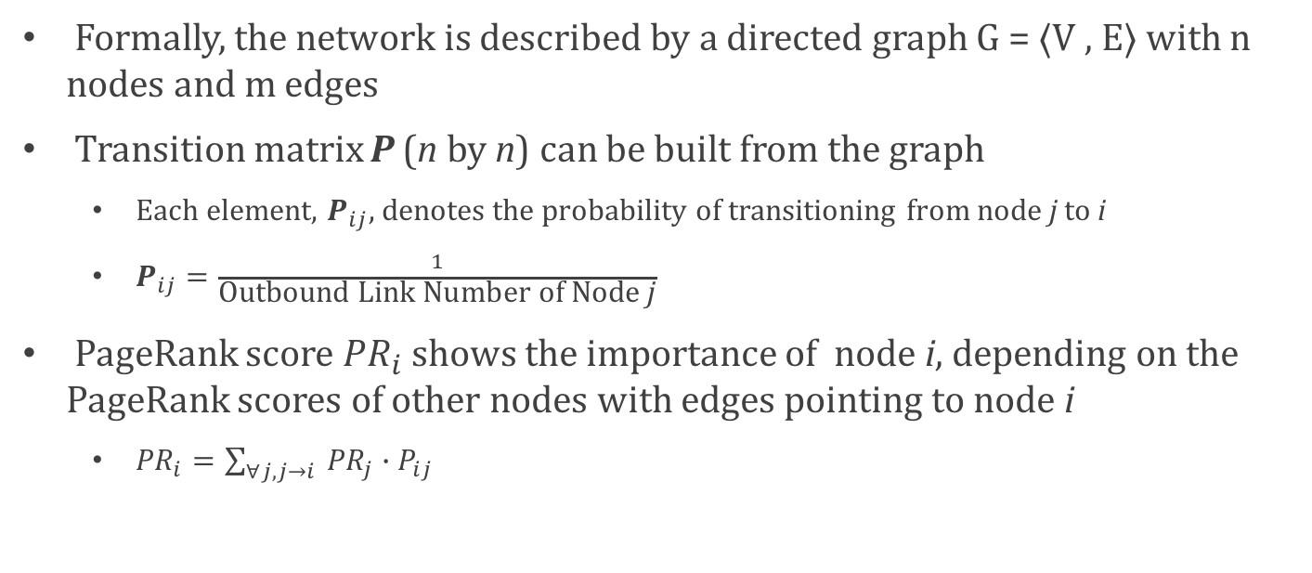
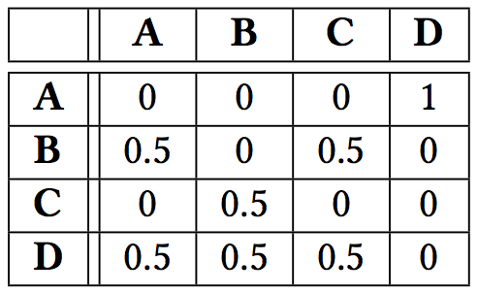
PageRank: Background
A small network with four web pages
Transition Matrix P

Slide 77
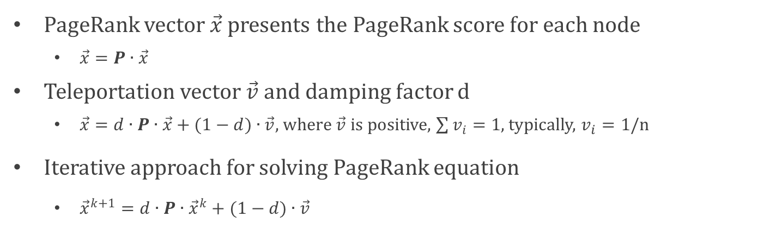
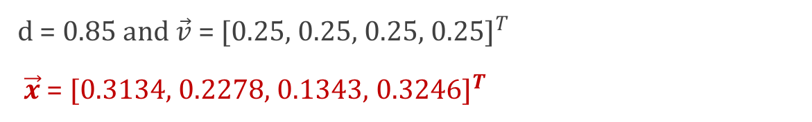
PageRank: Algorithm

Slide 78
PageRank-based fault localization (PRFL)
Execute twice on failing and passing test graphs, respectively
m1
m1
t1
m2
t4
t2
t3
m2
m3
m3

Slide 79
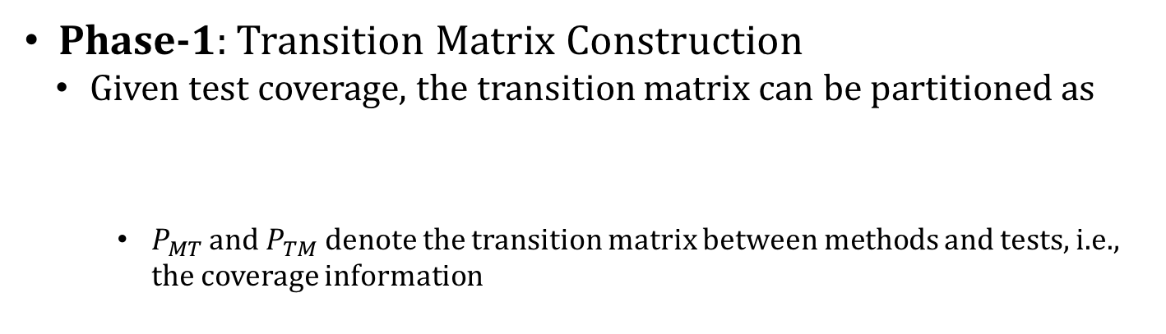
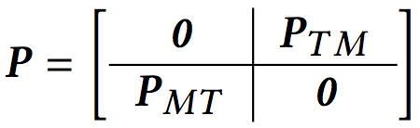
PageRank-based fault localization (PRFL)
m1
t1
m2
t4
t2
m3

Slide 80
PageRank-based fault localization (PRFL)
Phase-1:Transistion Matrix Construction
Methods connected with more fault-prone methods may also be fault-prone.
They may have propagated error states to other methods.
Therefore, method-to-method connections, Pmm, are also considered.
m2
m1
m3
m4

Slide 81
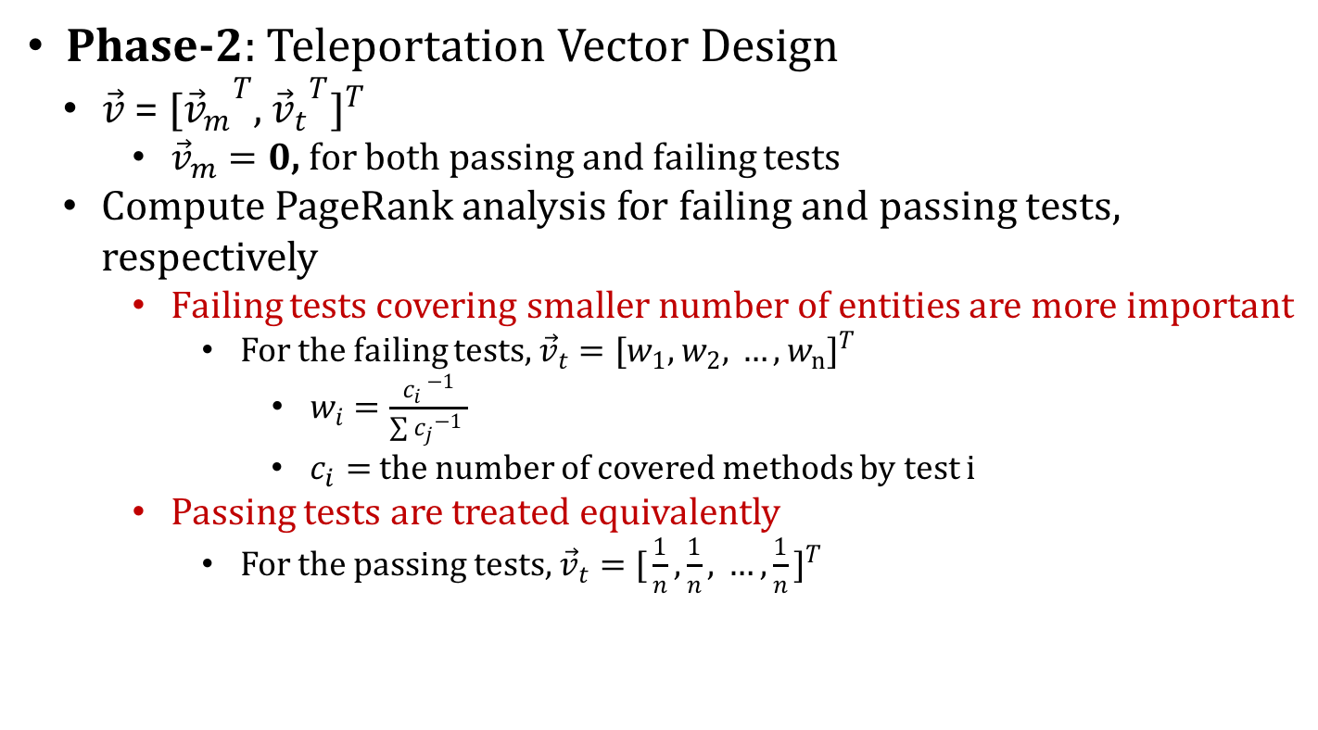
PageRank-based fault localization (PRFL)

Slide 82

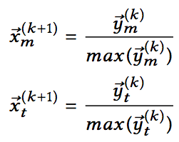
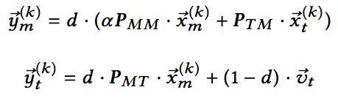
PageRank-based fault localization (PRFL)
Phase-3: Constrained PageRank Algorithm
Use parameter α to tune the weight of call graph
Iterative form of Constrained PageRank

Slide 83
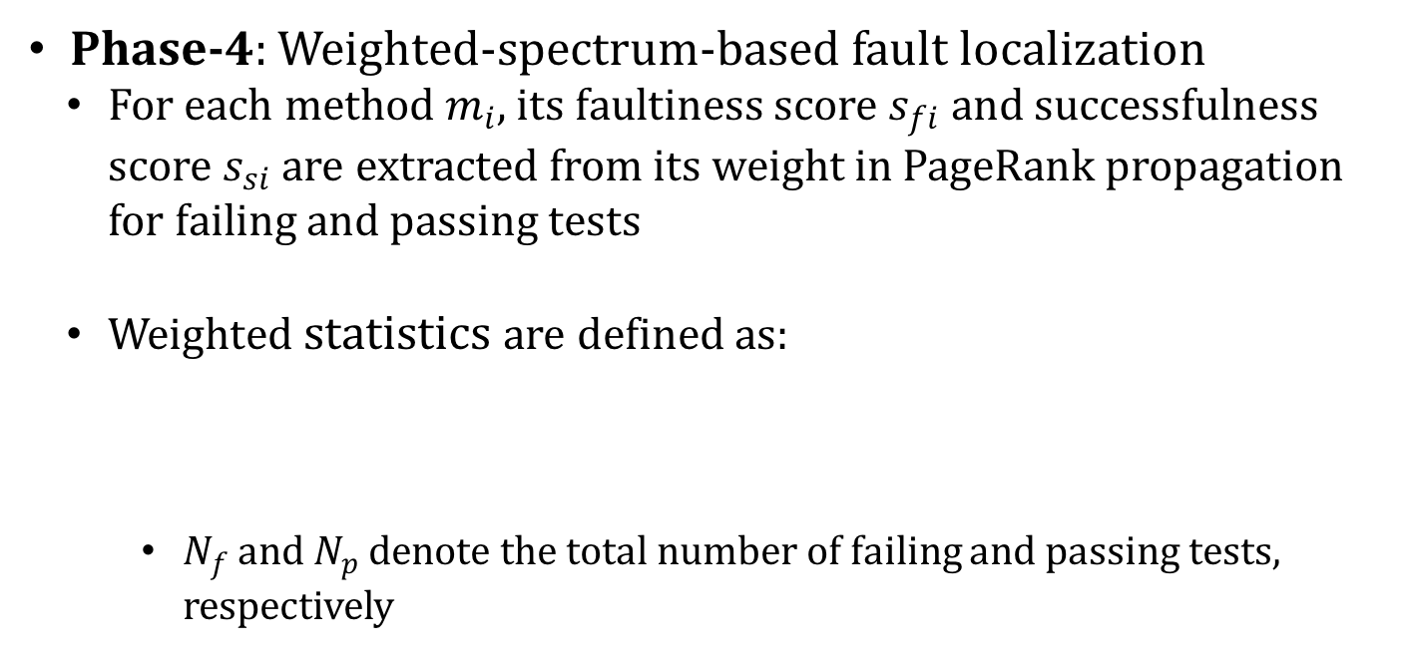


PageRank-based fault localization (PRFL)
, known as

Slide 84
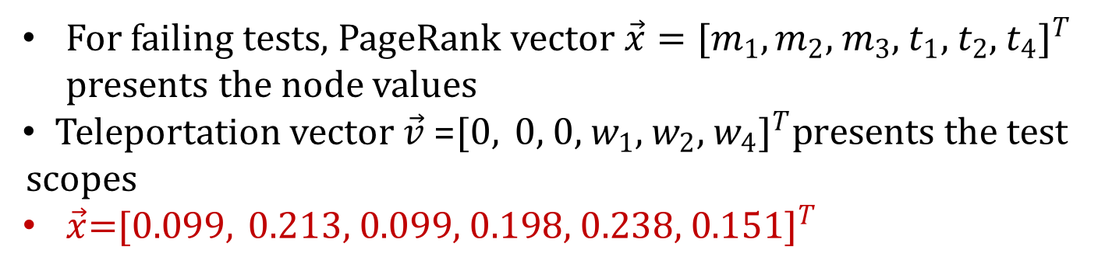
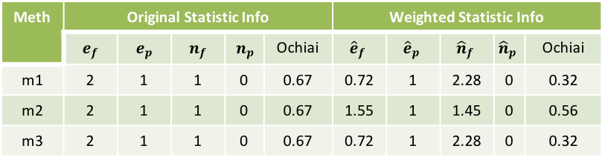
Example
m1
Meth | Original Statistic Info |  |  |  |  | Weighted Statistic Info
 |  |  |  |  | Ochiai |  |  |  |  | Ochiai
m1 | 2 | 1 | 1 | 0 | 0.67 | 0.72 | 1 | 2.28 | 0 | 0.32
m2 | 2 | 1 | 1 | 0 | 0.67 | 1.55 | 1 | 1.45 | 0 | 0.56
m3 | 2 | 1 | 1 | 0 | 0.67 | 0.72 | 1 | 2.28 | 0 | 0.32
t1
&
t3
m2
t2
t4
m3

Slide 85
Evaluations
On 357 real bugs from 5 well known Defects4J projects:
Ranking 104 bugs within Top-1, i.e., 42% more than the most effective traditional spectrum-based technique
On 30692 artificial bugs generated for 87 GitHub projects
Ranking 10352 bugs within Top-1, i.e., 55% more than the most effective spectrum-based technique

Slide 86
Onion peeling time
Let's comment this technique.

Slide 87
Savant (Le et al, ISSTA'16)
An invariant refers to some conditions that must be true at some point in time or even always while your program is executing.
For instance, x 0, x+y+3 = 0
Some intuitions about invariants:
Program elements which follow different invariants when run in failing versus correct executions are suspicious.
Such program elements are even more suspicious if they are assigned higher SBFL scores.
Some invariant differences are likely to be more suspicious than others.
Violation of x 0 might indicate a division by zero.
Violation of x+y+3 = 0 might indicate “linear shift”.
Overall, invariant changes imply...bugs.

Slide 88
Savant Framework
Savant has two phases
Learning phase: learns a statistical model that ranks methods based on the likelihood that they are the root cause of software failures.
method clustering and test case selection
invariant mining
feature extraction
model learning
Deployment phase:
takes as input a set of test cases, a faulty program
uses the learned model to rank a list of methods corresponding to the failing test cases

Slide 89
Learning phase: method clustering and test case selection
Ideally, run each method on all of its passing and failing tests to record execution traces for invariant inference.
It is too expensive.
Solution: run the method clusters on all of their passing and failing tests to record execution traces for invariant inference.
exclude methods that are not executed by any failing test.
cluster the rest methods by the passing tests executing them.
record execution traces for each cluster separately on the failing and passing test cases.

Slide 90
Learning phase: method clustering and test case selection (Ctnd.)
How to cluster?
vectorize spectra between methods and passing test cases
uses K-means algorithm:
k = I/M, I: total number of methods; M: desired maximum cluster size
passing test cases for each cluster should cover its methods at least T times each
M and T defined by uses.
 | t0 | t1 | t2 | t3 | t4 | t5
m0 | 1 | 1 | 0 | 0 | 1 | 1
m1 | 0 | 1 | 1 | 1 | 0 | 0
m2 | 1 | 0 | 0 | 1 | 0 | 1

Slide 91
Learning phase: invariant mining
Savant collects execution information separately for the methods in the cluster c using three sets of test cases: Fc, Pc, Fc Pc, where Fc denotes the failing test set, Pc denotes the passing test set, and Fc Pc denotes the union of the two.
Uses Daikon to infer the invariants as inv(Fc), inv(Pc), and inv(Fc Pc).

Slide 92
Learning Phase: Feature Extraction
Invariant Change Features
Daikon uses Invariant Diff to perform three types of comparisons per cluster: inv(Pc) inv(Fc Pc), inv(Fc) inv(Pc), and inv(Fc) inv(Fc Pc).
Then Invariant Diff can detect the changes between two invariants
for instance, “A OneOfString invariant learned from execution of Fc becomes a SingleString invariant in the execution of Pc”
All the changed pairs are collected as features
Suspiciousness Score Features
35 SBFL formulas

Slide 93
Learning Phase: Model Learning
Use learning-to-rank algorithm (rankSVM) to derive a model

Slide 94
Deployment Phase
takes the features generated for a new bug as input to the learned model
outputs a ranked list produced by the learned model to the developer for inspection

Slide 95
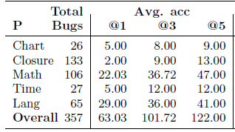
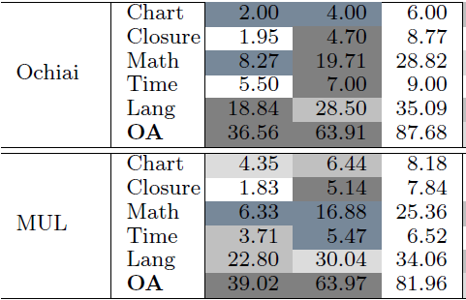
Evaluations
for others
for Savant

Slide 96
Onion peeling time
Let's comment this technique.

